Slide 1
Business Problems
Yearly Performance → How much Sales and Profit were generated each year, and whether the trend shows growth or decline.
Category & Sub-Category Analysis → Which categories and sub-categories contributed the most profit, and which ones went into loss.
Regional & State Performance → Which regions and states generated the highest revenue and profit.
Customer Segments → Which customer segment (Consumer, Corporate, Home Office) contributes the most.
Top Customers → Identify the top 5 customers each year, based on both Sales and Profit.
Discount Impact → Does offering higher discounts increase sales, or reduce profit margins?
Shipping Performance → Which shipping mode is most commonly used, and how is the average delivery time.
KPI Summary → Yearly key performance metrics like Sales, Profit, Orders, Average Order Value (AOV), Profit Margin %, and Delivery Days.

Slide 2
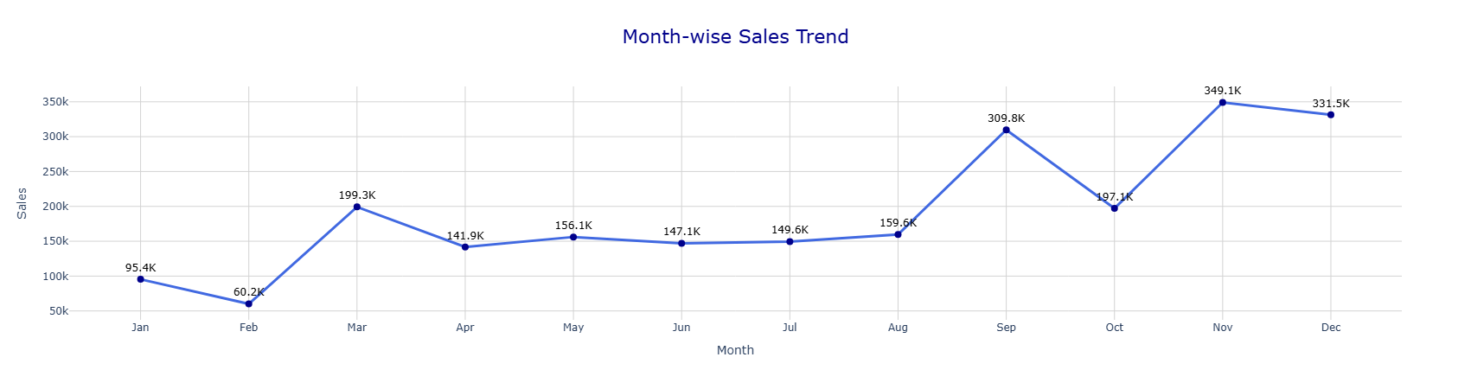
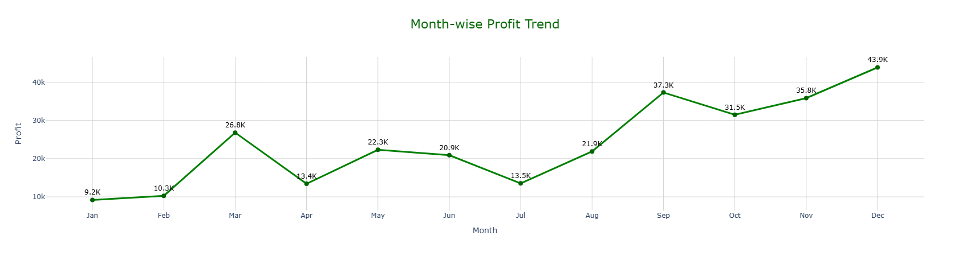

Slide 3
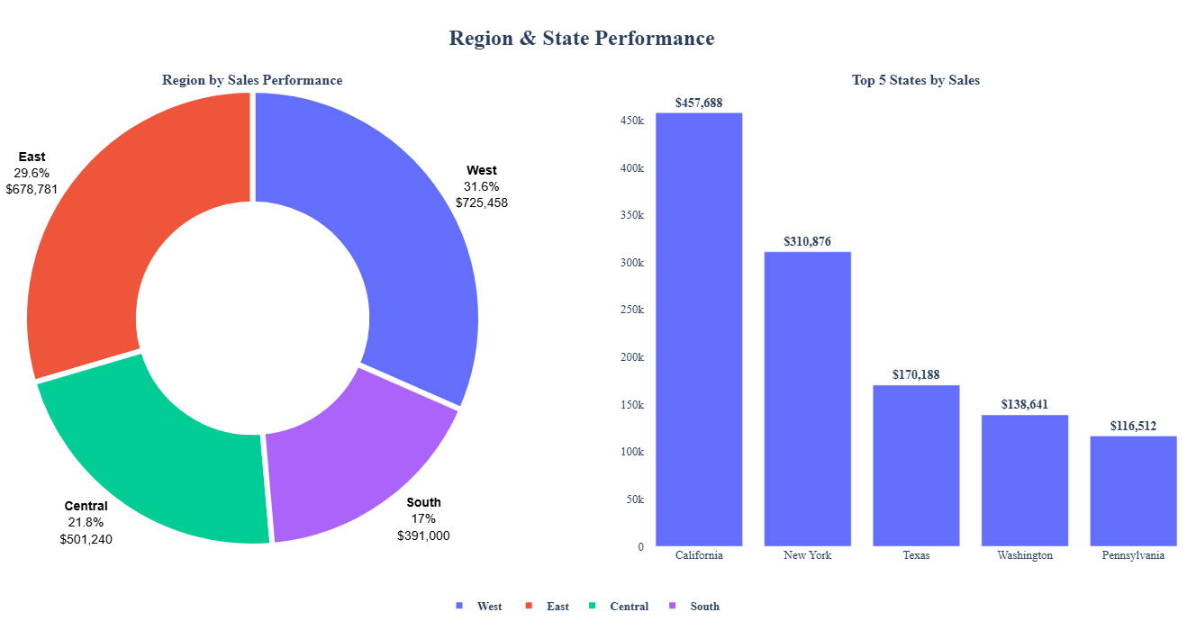

Slide 4
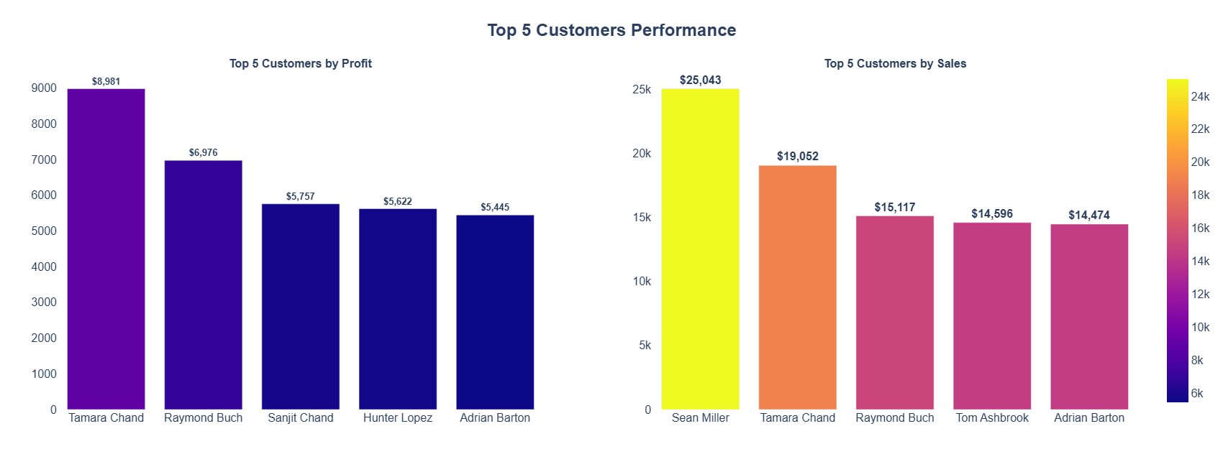
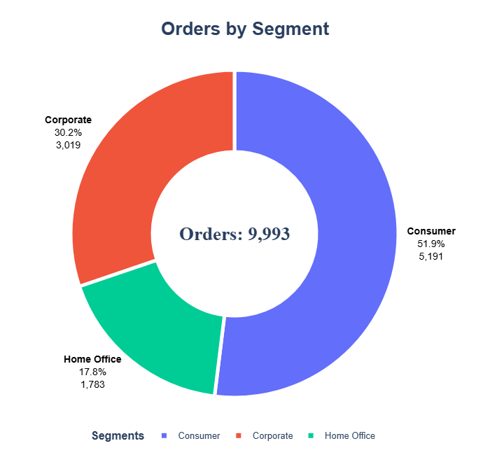

Slide 5
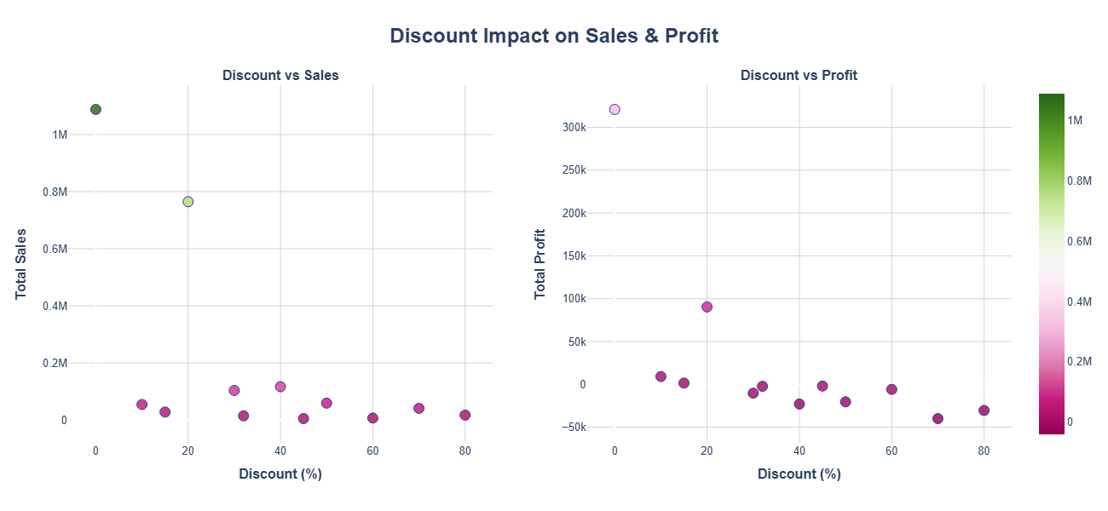

Slide 6
